Slide 1
Cypher decoder

Slide 2
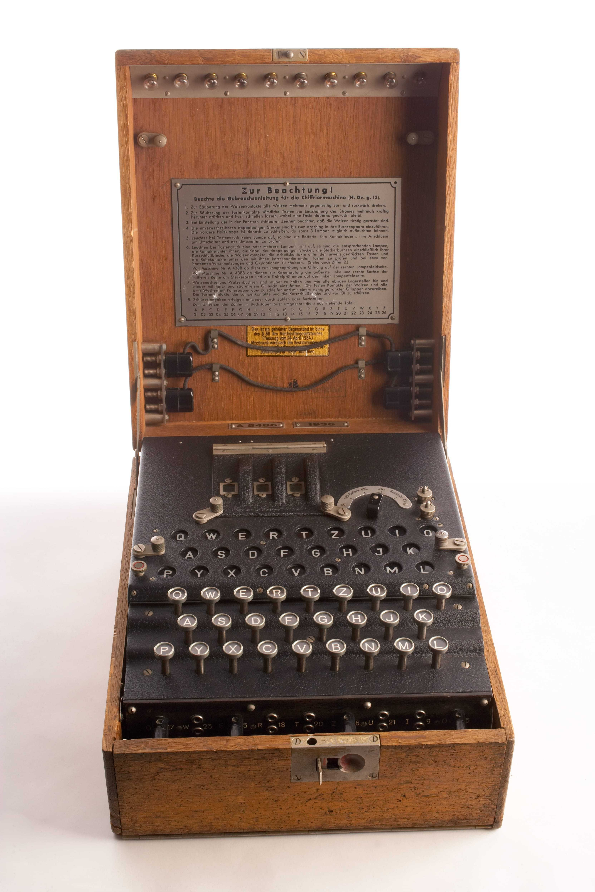
Agenda
Motivation
Cypher Explanation
Data
Baseline
Model
Notes:
https://www.google.com/url?sa=i&url=https%3A%2F%2Fwww.cia.gov%2Flegacy%2Fmuseum%2Fartifact%2Fenigma-machine%2F&psig=AOvVaw2U0Gch2Bann-w5gOYRpids&ust=1762362575784000&source=images&cd=vfe&opi=89978449&ved=0CBkQjhxqFwoTCKCLsKz-2JADFQAAAAAdAAAAABAE

Slide 3
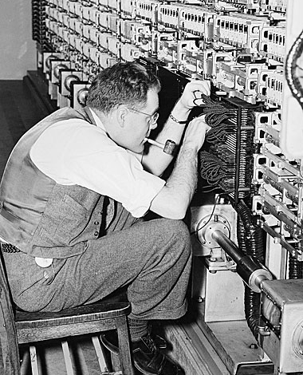
Motivation
Solve an interesting problem
Test the ability of a model to “reason”
Demonstrate progress in computer science over the past ~80 years
Goals:
Decode a substitution cipher at 95%
Decode Enigma ciphers at 75%
Compare this approach to the original solution
Have fun!
Notes:
https://www.google.com/url?sa=i&url=https%3A%2F%2Fwww.linkedin.com%2Fpulse%2Falan-turing-father-theoretical-computer-science-nandita-mahesh-efvcc&psig=AOvVaw2z6wDqKgZJ0GU6Mn7IAS8b&ust=1762402828994000&source=images&cd=vfe&opi=89978449&ved=0CBkQjhxqFwoTCPDD9KeU2pADFQAAAAAdAAAAABAV

Slide 4
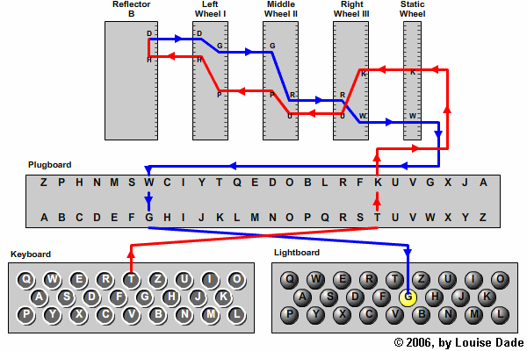
Cypher Explanations
Substitution Cypher:
Map letters in an alphabet to each other one-to-one
Write out a sentence and then replace the letters
Enigma Cypher:
Essentially, a substitution cipher that changes with each letter
3 of 5 potential rotors are put into the machine along with plugs and other scrambling settings
As each letter is typed, the rotors rotate, changing the substitution cypher
Notes:
https://medium.com/@goncalorrc/enigma-machine-in-python-part-1-b9e220a8eaf3

Slide 5
Data
Data Sources:
Actual naval transmission from WWII – Cool, but impractical
Enigma encoded text online – Convenient, but not large enough (500 lines)
Project Gutenberg text – Large enough to use

Slide 6
Data Examples
Shakespeare Sonnets:
Original:
From fairest creatures we desire increase,
That thereby beauty's rose might never die,
But as the riper should by time decease,
His tender heir might bear his memory:
But thou contracted to thine own bright eyes,
Feed'st thy light's
Processed:
Fromfairestcreatureswedesireincreasethattherebybeautysrosemightneverdiebutastheripershouldbytimedeceasehistenderheirmightbearhismemorybutthoucontractedtothineownbrighteyesfeedstthylights
Scramble:
Wgmowcjgbuqkgbcqegbuibrbujgbjlkgbcubqycqqybgbxfxbceqfugmubojvyqlbnbgrjbxeqcuqybgjsbguymezrxfqjobrbkbcubyjuqblrbgybjgojvyqxbcgyjuobomgfxeqqymekmlqgckqbrqmqyjlbmilxgjvyqbfbuw
Enigma:
AXITGIBLJEEDZRREAWDBYTQLOYVGYWRWWREIKFIVRLVCAGRMXVFUQNVPMSXECBPKNPNINESCTVFXFNLPJTYALSEZXKLTXECIWXUFFZOABYBVPZYZMGPHULLDDSQZDRXDKKDFZGDFJRQZDUGOAGYDABHSJVWWP
Original Transmissions:
Cypher text: TUKAQYYOOHVKJQTDVSBKRDDAZLOYXHRDEOZSPZOTBZMSBEIYASHHJKIMCZWYIKYJOEWQHDZWFNOADOEIOYKAUWVFPMHSYNUGIKEVFGBBAYPCGOTYSEPLSXQHKZNB
Decrypted:
UMSUEDDREIYYVIEGINSCHAUERNBISFUENFWOLKIGVEREINZELTSCHAUERKKBEREICHDORABISEINSXFUENFXABENDSKKSICHTACHTYYZEHNSMSEEZWOYBDREIDBV
Interpertation:
Um Süd 3 - 4 in Schauern bis 5 wolkig vereinzelt Schauer "(Bereich Dora bis 1.5. Abends)" Sicht 8-10 Seemeilen Seegang 2-3 (DBV)
English:
[Wind from] around the south [force] 3 to 4 [with] showers, up to [force] 5 cloudy [with] isolated showers. (Area D up to evening of 1st May.) Visibility 8 to 10 nautical miles, sea state 2 to 3.

Slide 7
Baseline Evaluations
Word Frequency
Make a dictionary of letters and counts in an input string
Map the most common counts to a ranking of the most common letters
Performance:
Scramble: 4.54%
Enigma: 4.09%
Basic Transformer
Basic transformer setup similar to HW3
Performance:
Scramble: 33.46% (1198934/3582976)
Enigma: 38.11% (14149/37128)*
Models are evaluated on character accuracy

Slide 8
Model – Transformer
I plan on using a Transformer-based architecture that “translates” from the encoded string to a decoded string
As a baseline, I am currently using a hard-coded model similar to HW3
This model may be too small
Next steps:
Bulk up my hardcoded model
Substitution-Cyphet-Text-Eng from Huggingface
GoogleT5 from Huggingface

Slide 9
Thank you!

